Slide 1

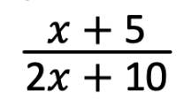
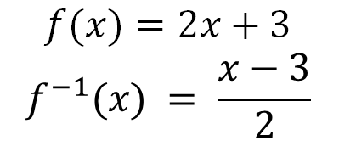
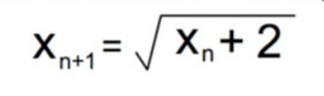
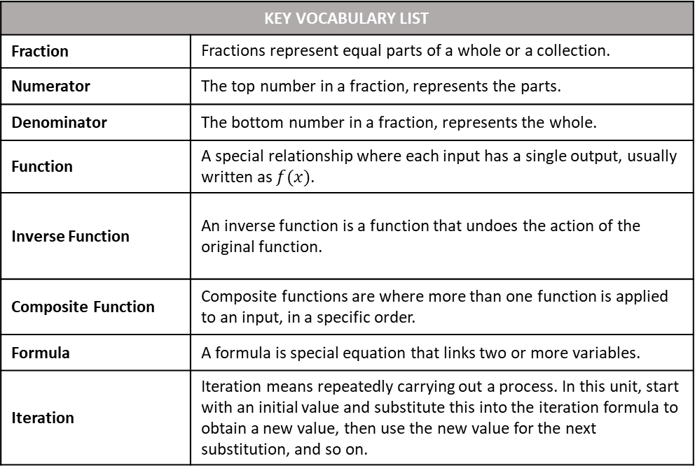
Name
Class
Tutor Group
YEAR 11 MATHEMATICS
Unit 1: Further Algebra Rearranging Formulae, Quadratic Simultaneous Equations, Algebraic Fractions, Functions, Iteration, Proof
KEY VOCABULARY LIST
Fraction | Fractions represent equal parts of a whole or a collection.
Numerator | The top number in a fraction, represents the parts.
Denominator | The bottom number in a fraction, represents the whole.
Function | A special relationship where each input has a single output, usually written as $f(x)$.
Inverse Function | An inverse function is a function that undoes the action of the original function.
Composite Function | Composite functions are where more than one function is applied to an input, in a specific order.
Formula | A formula is special equation that links two or more variables.
Iteration | Iteration means repeatedly carrying out a process. In this unit, start with an initial value and substitute this into the iteration formula to obtain a new value, then use the new value for the next substitution, and so on.

Slide 2
CONTENTS |  | PAGE
SUBTOPIC 1 | Rearranging Formulae/ Changing the Subject | 5
 | GCSE QUESTIONS | 16
SUBTOPIC 2 | Recap/ Prior Knowledge Quiz: Solving Quadratic Equations
SUBTOPIC 3a | Simultaneous Equations – elimination and graphical solving
SUBTOPIC 3b | Recap: Solving Simultaneous Equations by Elimination
SUBTOPIC 3c | Worded Simultaneous Equations
 | GCSE QUESTIONS
SUBTOPIC 3d | Solving Simultaneous Equations using Substitution
SUBTOPIC 3e | Quadratic Simultaneous Equations
 | GCSE QUESTIONS
SUBTOPIC 4a | Algebraic Fractions – Manipulation and Simplifying
 | GCSE QUESTIONS
SUBTOPIC 4b | Algebraic Fractions – Solving (including Quadratics)
 | GCSE QUESTIONS
SUBTOPIC 5 | Functions
 | GCSE QUESTIONS
SUBTOPIC 6a | Iteration 1: Recurrence Relationships
 | GCSE QUESTIONS
SUBTOPIC 6b | Iteration 2: Estimating Solutions
 | GCSE QUESTIONS
SUBTOPIC 6 | Algebraic Proof
 | GCSE QUESTIONS
BOOKLET STRUCTURE
Start of subtopic:
Read and annotate the information in the Frayer model or introduction text
I do (teacher led example).
We do (teacher and scholar led example).
You do (independent scholar example).
Whiteboard check.
Independent practice and mixed practice.
End of subtopic:
GCSE questions – to ensure you are confident with the style you will encounter in your exams

